Slide 1
ESFP – II Project
Made by: Rishi raj ojha

Slide 2
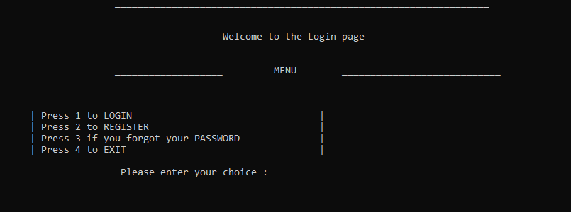
Project is on Login form

Slide 3
Header files used on this project:
Header files used are:
<iostream>
<String.h>
<fstream> to read and write

Slide 4
Concept used:
Firstly we created three functions login, registration and forgot functions.
Inside the main function I made a menu for login form that have some of the choices.
Then I have used switch cases for the choice like :
Case 1: login
Case 2: registration
Case 3: forgot
Case 4: exit
And then used system (cls) to clear the screen after every process.
Then in login function I created an integer value count and string value userId, password, id, pass.
Then I made a ifstream file for reading the data which I named as record.txt

Slide 5
In login form user can login using username and password. Then I created a registration form where user can register into it and the data will be stored in record.txt file, which is created already.
In case where if someone forgot its username or password he can also find the password using the function created named as forgot.
Here you have to enter the username and password will be displayed , if the username I wrong there will a message displayed as “Sorry! Your account is not found! ”
This whole code is based on file handling, if-else, switch case and function concept.
To see the code kindly click on the below link:
https://github.com/R1shi45/Login-form.git

